Slide 1
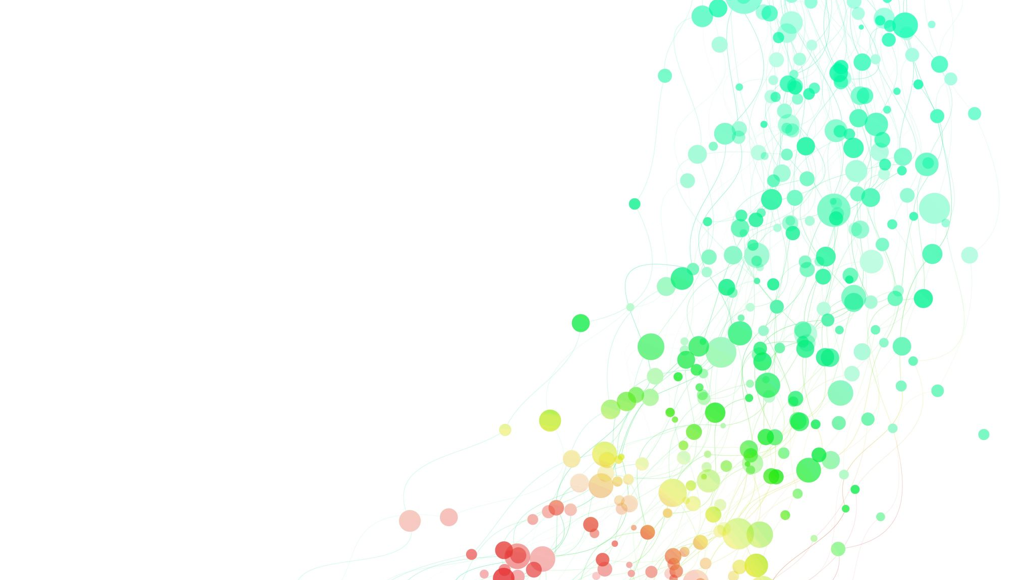
MLDV Project Report Heart Disease Prediction
Julius Chan
2082753A

Slide 2
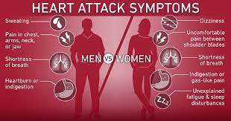
Introduction
Every day, the average human heart beats around 100,000 times, pumping 2,000 gallons of blood through the body.
The objective on this project is to forecast if a patient has a heart condition or not based on the patient's provided qualities such as Gender & Age , and another is to diagnose and uncover various insights from this dataset that might aid in better comprehending the situation. Given clinical parameters about a patient, can we predict whether they have heart disease?
The results of the diagnosis on heart disease should be thoroughly conveyed to the patient. To put it another way, the doctor should be able to explain to the patient which certain features affected the diagnosis results.

Slide 3
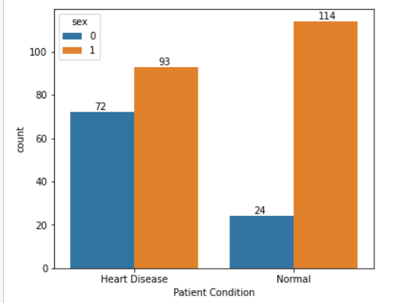
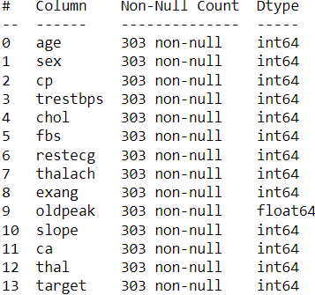
Data Exploration & Data Preparation
This is a multivariate dataset, meaning it contains several statistical variables as well as multivariate numerical data analysis. The dataset has 14 attributes and 303 rows of patient records.
There are 165 patients who have been diagnosed with heart disease, whereas 138 patients are heart disease-free. Males are more prone to heart disease compared to females.
No missing value or inconsistency is detected in the dataset.
Data is clean and ready to be processed.
0 = Female. 1 = Male

Slide 4
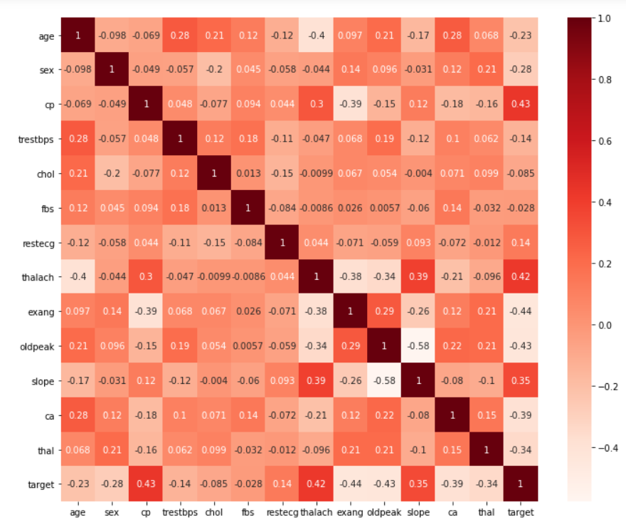
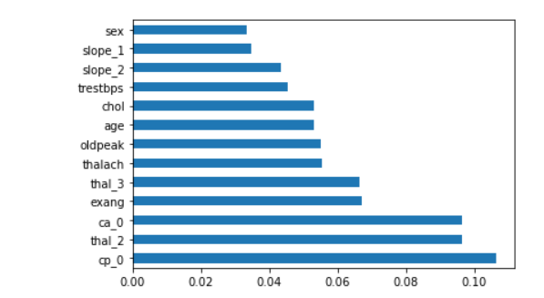
Feature Selection
Correlation Heatmap
The dataset's top features were extracted using the Extra Tree Classifier Model to see all the important model features. ‘age’, ‘trestbps’, ‘chol’, ‘thalach’, ‘exang’, ‘oldpeak’, ‘cp_0’, ‘slope_2’, ‘ca_0’, ‘thal_2’, ‘thal_3’ were all selected features.

Slide 5
Results & Analysis
Classification Report
Ensemble Learning Report
Model | Accuracy% (Train) | Accuracy% (Test) | Precision (Test) | Recall (Test) | F1-Score (Test)
RFC | 100% | 79.12% | 0.82 | 0.78 | 0.80
GBC | 97.17% | 75.82% | 0.83 | 0.70 | 0.76
ADA | 92.92% | 76.92% | 0.82 | 0.74 | 0.77
ETC | 100% | 78.02% | 0.82 | 0.76 | 0.79
BAG | 98.11% | 78.02% | 0.84 | 0.74 | 0.78
Model | Accuracy% (Train) | Accuracy% (Test) | Precision (Test) | Recall (Test) | F1-Score (Test)
LR | 86.79% | 85.71% | 0.86 | 0.88 | 0.87
LDA | 86.79% | 83.52% | 0.84 | 0.86 | 0.85
KNN | 87.26% | 81.32% | 0.81 | 0.86 | 0.83
CART | 89.51% | 76.92% | 0.85 | 0.70 | 0.76
SVM | 89.15% | 83.52% | 0.85 | 0.84 | 0.84
As seen in both reports. Due to its high-test accuracy, precision, recall, and F1 score, Logistic Regression fared the best in Classification while Random Forest Classification fared the best in Ensemble Learning.

Slide 6
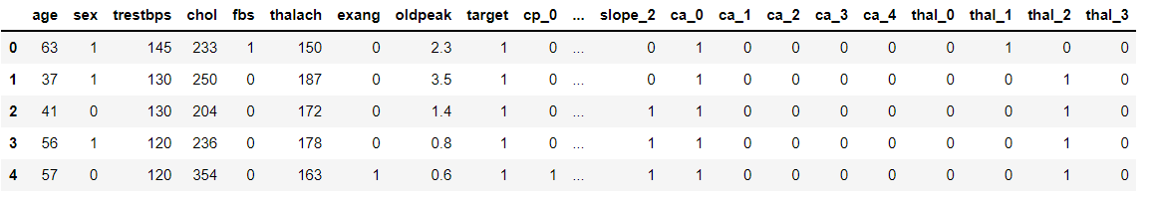
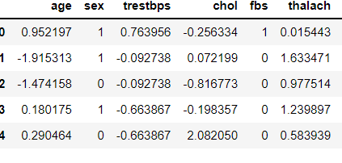
Methods & Improvements
To reduce bias, One Hot Encoding is performed to categorical attributes ['cp','restecg','slope', 'ca', 'thal']. The feature were rearranged, which improves the model’s accuracy even further.
Numeric attributes ['age','trestbps','chol','thalach','oldpeak'] are scaled from -1 to 1 using Standard Scaler to standardize the data.
Dataset is split into 70% Training Set & 30% Testing Set.
Standard Scaler
One Hot Encoding

Slide 7
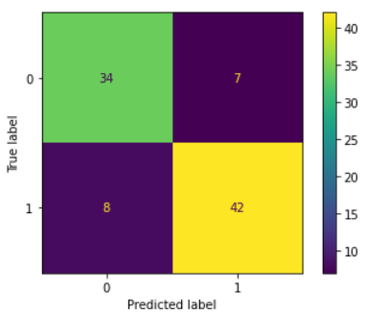
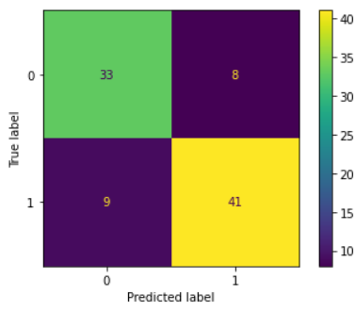
Hyperparameter Tuning
Base Model Results
Model | Accuracy% (Train) | Accuracy% (Test) | Precision (Test) | Recall (Test) | F1-Score (Test)
LR | 86.79% | 85.71% | 0.86 | 0.88 | 0.87
RFC | 100% | 79.12% | 0.82 | 0.78 | 0.80
Tuned LR Confusion Matrix
Tuned RFC Confusion Matrix
In the model evaluation, Logistic Regression and Random Forest Classifier performed the best. Both models are chosen for Hyperparameter Tuning via GridsearchCV to determine whether the results may be further improved.
Parameter tuning assist to improve RFC results. Logistic Regression results didn’t improve. This might imply that the base model is doing well enough, or the dataset is small.
After Tuning via Gridsearch
Model | Accuracy% (Train) | Accuracy% (Test) | Precision (Test) | Recall (Test) | F1-Score (Test)
Tuned LR | 87.26% | 83.52% | 0.85 | 0.84 | 0.84
TUNED RFC | 91.51% | 81.32% | 0.84 | 0.84 | 0.84

Slide 8
Conclusion
At the end of the notebook, the objective has been accomplished by determining the correlation between key features and the target variable. Starting with an evaluation on the base models, the best model has been selected and used for hyperparameter tunning to see whether the results improve.
What are indicators of heart disease? Gender and age do have a significant importance but are less important indicators in predicting heart disease than the number of major arteries, forms of chest pain, exercise-induced angina, and Thalassemia, a blood disorder.
Using internet information such as Google would indicate that cholesterol and age would be key factors in the model to predict heart disease. That was not evident in this dataset's model. Based in this Machine Learning Project, the important indicators were the number of major vessels and the forms of chest pains.

Slide 9
References
https://archive.ics.uci.edu/ml/datasets/Heart+Disease
https://seaborn.pydata.org/
https://scikit-learn.org/stable/modules/generated/sklearn.metrics.classification_report.html
https://www.kaggle.com/ronitf/heart-disease-uci
https://www.kaggle.com/faressayah/decision-trees-random-forest-for-beginners
https://scikit-learn.org/stable/modules/ensemble.html
https://scikit-learn.org/stable/modules/generated/sklearn.preprocessing.StandardScaler.html
https://scikit-learn.org/stable/modules/grid_search.html

